Slide 1
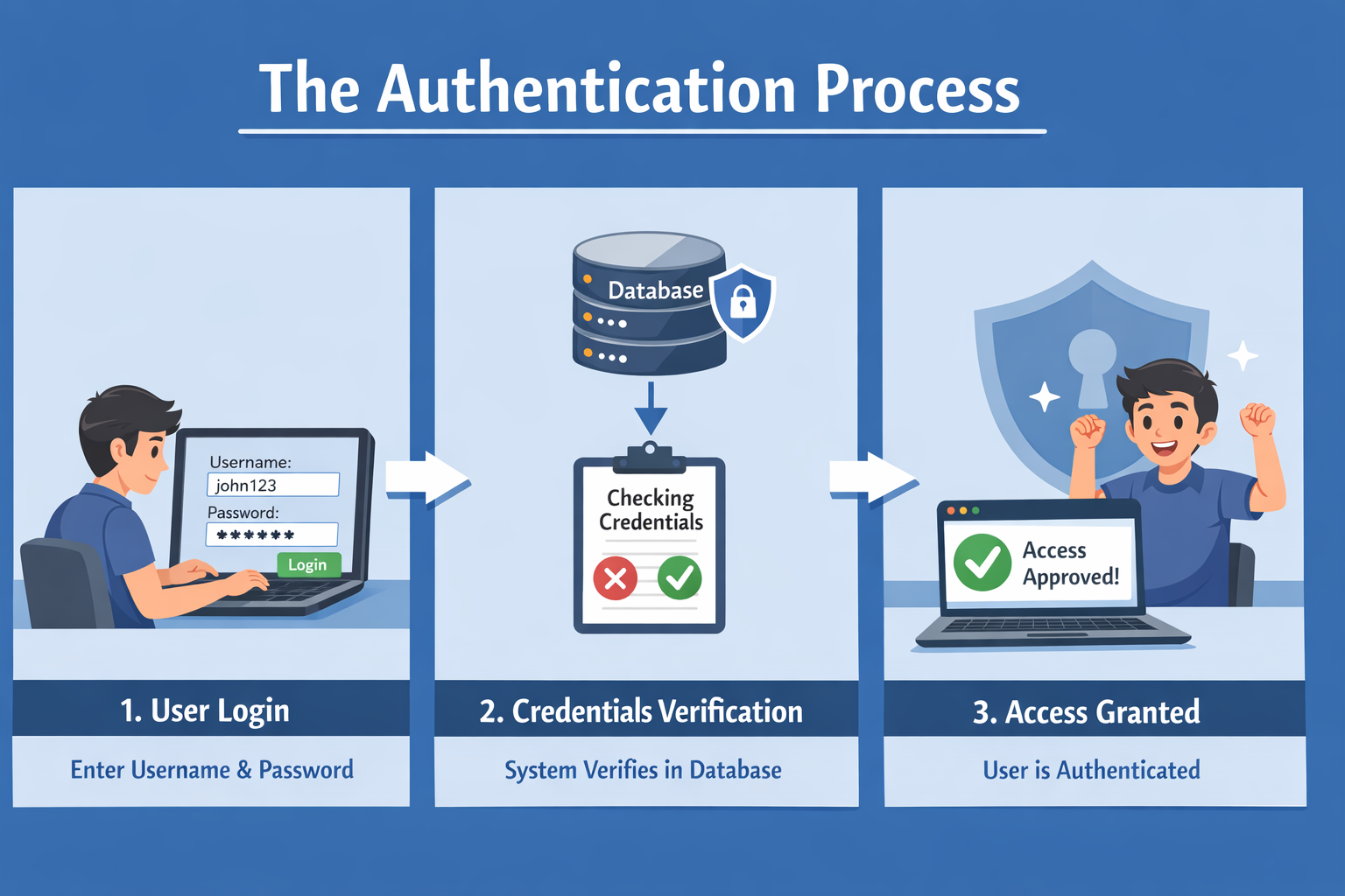
What is Authentication?

Slide 2
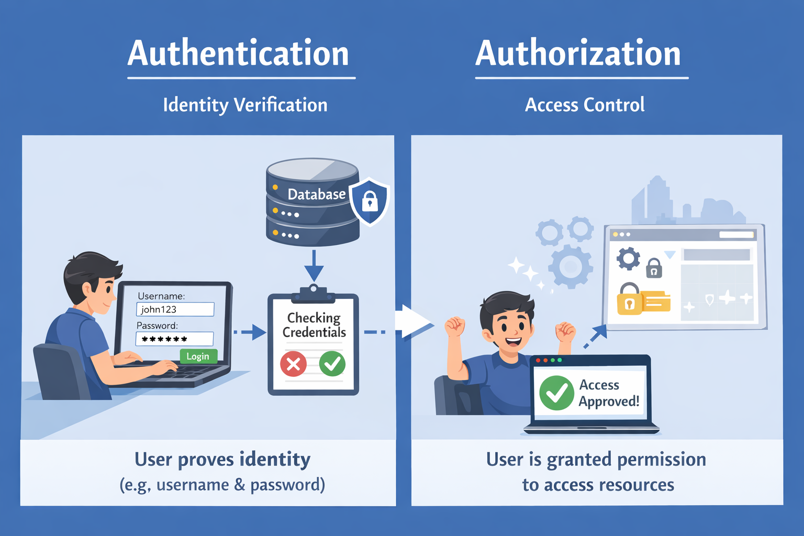
Authentication vs Authorization

